Slide 1
Chapter 7 Information Age Warfare, Online Crime & Punishment

Slide 2
Table of Contents
Introduction
History of warfare
The Technology of War
War News
Cyber Wars
Satellites - The View from Space
Star Wars Technology
Network-centric warfare

Slide 3
Table of Contents
Introduction to Online Crime
A brief history of crime and computers
Computer Fraud
Hacking
Identity Theft and Credit Card Fraud
Malware
Cyber crime and Cyber Attacks

Slide 4
Table of Contents
Laws Against Computer Misuse and Cyberlaw
US Computer Misuse Act
US Sequence of Laws
Council of Europe Convention of Cybercrime
Cyberlaws of Malaysia

Slide 5
Introduction
Today the military arena is dominated by global conflicts within an information age
Warfare and conflict now also include political and fundamentalist adversaries who wage war from within the online environment
Society also places increasing reliance on electronic control systems which causes huge potential for cyber-attack and a breakdown in a nation’s communications infrastructure, by targeting areas such as air-traffic control, public utilities, civil administration and telecommunications.

Slide 6
Introduction
When people is watching military and terrorist conflicts from armchairs, media and information control becomes a key weapon to provide positive and negative influences in the way people perceive the nature of the conflict and the reasons for it.

Slide 7
HISTORY OF WARFARE

Slide 8
History of Warfare
Warfare uses tremendous amounts of technology
E.g. synchronization of machine guns to fire through aircraft propeller blades, major breakthrough in aviation fighting in the First World War
E.g. World War, the development of radar systems allowed for the early warning of incoming aircraft, which previously could only be detected by visual sightings
WWII – encryption algorithms by Alan Turing
War accelerates development of technology:
WWII – brought digital computers

Slide 9
History of Warfare
Internet development brought about by Sputnik. US Department of Defense created the Advanced Research Projects Agency (ARPA) – led to first network linking 4 universities in US
Advanced research Project Agency Network (ARPANET): the forerunner of the Internet

Slide 10
History of Warfare
Internet fostering the development of technology and also its negative consequences: hacking & terrorism
Anarchist's Cookbook
details for making explosives from household chemicals
detonation device construction and similar material
how to hide objects so that they will not be detected during frisking;
cryptographic techniques for use with physical as well as electronic messages.
downloadable without detection

Slide 11
THE TECHNOLOGY OF WAR

Slide 12
The Technology of War
The technologies employed by societies in conflict are closely related to the social and technical developments of the period:
Agricultural revolution
Industrial revolution
Information age

Slide 13
The Technology of War
Wars were linked to the acquisition of land, property and wealth and then later to industrial and commercial resources.
Today, conflicts are also linked to the desire for nations and nation states to control data, knowledge and the consumable resources needed to sustain mankind.

Slide 14
The Technology of War
What is today’s weapons technology?
Computer Technology:
E.g. military environments: strategic decisions and military scenarios are generated by computer technology, solutions are analyzed and strategies determined from the data to ensure success and to minimize one’s own casualties.
Today, we rely on high-speed, electronic, encoded communications across and between battlefields which can be local or global.
However, is communications technology secure?

Slide 15
The Technology of War
Cyber-warfare has now developed not only in terms of breaching or interfering with military systems but, possibly more importantly, entering, altering and controlling worldwide economies and commercial environments such as banking, major corporations, criminal records and so on.
Information-age warfare is not restricted to the battlefield; the tools available can be used to influence potential enemies before and after the conflict.

Slide 16
War News
modern communications technologies and the development of photography had substantially changed war reporting
potential political bias of war reporting have always been controversial
modern technology is creating a new culture of amateur or ‘citizen’ reporters. Members of the public use mobile phone photographs, videos and text messages to report an event before official news crews can get anywhere near the scene – “backpack journalism”
The Technology of War

Slide 17
Cyber-Wars
Electro-Magnetic Pulse (EMP) generated by atomic explosions would destroy and render useless many of the electrical and electronic systems controlling public utilities.
Practically all commercial, military and personal systems are computer controlled and many are linked to the Internet 🡪 there are many ways to sabotage these controlling networks
Virus attacks on systems worldwide, where programs are introduced to cause chaos and destroy systems through the use of worms and Trojan horses
The Technology of War

Slide 18
Cyber-Wars
Small company - Acxiom is the world's largest processor of consumer data; its customers include 9 of the top 10 US credit-card issuers, as well as nearly all the retail banks, insurers and automobile manufacturers
after the FBI released the names of some of the hijackers following the 9/11 tragedy in New York, Acxiom ran a computer search and located some of them in its databases
Government interconnected with commercial databases
The Technology of War

Slide 19
Satellites – the View from Space
Commercial applications
television transmissions
global positioning
data communications
Internet traffic
The Technology of War

Slide 20
Satellites – the View from Space
Military applications
Surveillance
Espionage
Secure communications
Potential delivery of offensive and defensive weapons systems.
The Technology of War

Slide 21
Satellites – the View from Space
Satellite-data-driven tools such as Google Earth are also now being used by terrorists to help plan their attacks
Number of satellites is huge! 10 times more satellite capacity being used during the Iraq War (2003) than the Gulf War (1991)
For example, although many precision-guided weapons use the US-operated global positioning system (GPS) satellite constellation or laser guidance, some weapons (such as unmanned Predator drones)
The Technology of War

Slide 22
Satellites – the View from Space
Cruise missiles may also transmit live video footage or receive updated target information via satellite.
1967 Outer Space Treaty - outlaws the use of offensive weapons in orbit
The Technology of War

Slide 23
Star Wars Technology
There is growing evidence that space will become an increasingly important environment for weapons and systems.
Will new arms race emerge?
E.g. US, Russia, China and India are aggressively pursuing military space programmes
The Technology of War

Slide 24

Source: https://nypost.com/2018/06/18/trump-calls-for-new-space-force-as-part-of-us-military/

Slide 25
Star Wars Technology
Now US military space programme is on the creation of a missile defence system: a laser defence network designed to shoot down incoming enemy ballistic missiles.
In future: develop offensive weapons with the ultimate ambition of achieving ‘full-spectrum dominance’ in all areas of warfare.
Such a network would enable real-time predictive information to locate, identify, track and target enemies on any battlefield on Earth.
The Technology of War

Slide 26
Network-centric Warfare
In the future it is expected that warfare will experience a shift from being platform-centric, concentrating on its vehicles, to being network-centric, built around a system of shared data and communications
E.g. the development of smart missiles with radar-link sensors and short-range weapons with similar velocities to tank shells will provide a substantial advantage over the enemy.
The Technology of War

Slide 27
Network-centric Warfare
the soldiers of tomorrow can be deployed in hostile conditions in relatively small numbers and launch multiple weapon systems from safe locations
smart robots which would replace humans in the battlefield
The Technology of War

Slide 28
INTRODUCTION TO ONLINE CRIME

Slide 29
Hacking
Intentional, unauthorized access to computer systems
The term has changed over time
Phase 1: The joy of programming
Early 1960s to 1970s
It was a positive term
A "hacker" was a creative programmer who wrote elegant or clever code
A "hack" was an especially clever piece of code
Introduction to Online Crime

Slide 30
Hacking
Phase 2: 1970s to mid 1990s
Hacking took on negative connotations
Breaking into computers for which the hacker does not have authorized access
Still primarily individuals
Includes the spreading of computer worms and viruses and ‘phone phreaking’
Companies began using hackers to analyze and improve security
Introduction to Online Crime

Slide 31
Hacking
Phase 3: The growth of the Web and mobile devices
Beginning in mid 1990s
The growth of the Web changed hacking; viruses and worms could be spread rapidly
Political hacking (Hacktivism) surfaced
Denial-of-service (DoS) attacks used to shut down Web sites
Large scale theft of personal and financial information
Introduction to Online Crime

Slide 32
Hacking
Is “harmless hacking” harmless?
Responding to nonmalicious or prank (trick) hacking uses resources.
Hackers could accidentally do significant damage.
Almost all hacking is a form of trespass.
Introduction to Online Crime

Slide 33
Hacking
Hacktivism, or Political Hacking
Use of hacking to promote a political cause
Disagreement about whether it is a form of civil disobedience and how (whether) it should be punished
Some use the appearance of hacktivism to hide other criminal activities
How do you determine whether something is hacktivism or simple vandalism?
Introduction to Online Crime

Slide 34
Hacking
Hackers as Security Researchers
“White hat hackers” use their skills to demonstrate system vulnerabilities and improve security
Introduction to Online Crime

Slide 35
Hacking
Hacking as Foreign Policy
Hacking governmental databases has increased
Pentagon has announced it would consider and treat some cyber attacks as acts of war, and the U.S. might respond with military force.
How can we make critical systems safer from attacks?
Introduction to Online Crime

Slide 36
Hacking
Stuxnet
An extremely sophisticated worm
Targets a particular type of control system
Beginning in 2008, damaged equipment in a uranium enrichment plant in Iran
Introduction to Online Crime

Slide 37
Hacking
Security
Hacking is a problem, but so is poor security.
Variety of factors contribute to security weaknesses:
History of the Internet and the Web
Inherent complexity of computer systems
Speed at which new applications develop
Economic and business factors
Human nature
Introduction to Online Crime

Slide 38
Hacking
Security
Internet started with open access as a means of sharing information for research.
Attitudes about security were slow to catch up with the risks.
Firewalls are used to monitor and filter out communication from untrusted sites or that fit a profile of suspicious activity.
Security is often playing catch-up to hackers as new vulnerabilities are discovered and exploited.
Introduction to Online Crime

Slide 39
Hacking
Responsibility for Security
Developers have a responsibility to develop with security as a goal.
Businesses have a responsibility to use security tools and monitor their systems to prevent attacks from succeeding.
Home users have a responsibility to ask questions and educate themselves on the tools to maintain security (personal firewalls, anti-virus and anti-spyware).
Introduction to Online Crime

Slide 40
Hacking
Discussion Questions
Is hacking that does no direct damage a victimless crime?
Do you think hiring former hackers to enhance security is a good idea or a bad idea? Why?
Introduction to Online Crime

Slide 41
Hacking
The Law: Catching and Punishing Hackers
1984 Congress passed the Computer Fraud and Abuse Act (CFAA)
Covers government computers, financial and medical systems, and activities that involve computers in more than one state, including computers connected to the Internet
Under CFAA, it is illegal to access a computer without authorization
The USA PATRIOT Act expanded the definition of loss to include the cost of responding to an attack, assessing damage and restoring systems
Introduction to Online Crime

Slide 42
Hacking
The Law: Catching and Punishing Hackers
Catching hackers
Law enforcement agents read hacker newsletters and participate in chat rooms undercover
They can often track a handle by looking through newsgroup or other archives
Security professionals set up ‘honey pots’ which are Web sites that attract hackers, to record and study
Computer forensics specialists can retrieve evidence from computers, even if the user has deleted files and erased the disks
Investigators trace viruses and hacking attacks by using ISP records and router logs
Introduction to Online Crime

Slide 43
Hacking
The Law: Catching and Punishing Hackers
Penalties for young hackers
Many young hackers have matured and gone on to productive and responsible careers
Temptation to over or under punish
Sentencing depends on intent and damage done
Most young hackers receive probation, community service, and/or fines
Not until 2000 did a young hacker receive time in juvenile detention
Introduction to Online Crime

Slide 44
Hacking
The Law: Catching and Punishing Hackers
Criminalize virus writing and hacker tools?
Introduction to Online Crime

Slide 45
Hacking
The Law: Catching and Punishing Hackers
Expansion of the Computer Fraud and Abuse Act
The CFAA predates social networks, smartphones, and sophisticated invisible information gathering.
Some prosecutors use the CFAA to bring charges against people or businesses that do unauthorized data collection.
Is violating terms of agreement a form of hacking?
Introduction to Online Crime

Slide 46
Identity Theft & Credit Card Fraud
Stealing Identities
Identity Theft –various crimes in which criminals use the identity of an unknowing, innocent person
Use credit/debit card numbers, personal information, and social security numbers
18-29 year-olds are the most common victims because they use the Web most and are unaware of risks
E-commerce has made it easier to steal and use card numbers without having the physical card
Introduction to Online Crime

Slide 47
Identity Theft & Credit Card Fraud
Stealing Identities
Techniques used to steal personal and financial information
Requests for personal and financial information disguised as legitimate business communication
Phishing – e-mail
Smishing – text messaging
Vishing – voice phishing
Pharming – false Web sites that fish for personal and financial information by planting false URLs in Domain Name Servers
Online resumés and job hunting sites may reveal SSNs, work history, birth dates and other information that can be used in identity theft
Introduction to Online Crime

Slide 48
Identity Theft & Credit Card Fraud
Responses to Identity Theft
Authentication of email and Web sites
Use of encryption to securely store data, so it is useless if stolen
Authenticating customers to prevent use of stolen numbers, may trade convenience for security
In the event information is stolen, a fraud alert can flag your credit report; some businesses will cover the cost of a credit report if your information has been stolen
Introduction to Online Crime

Slide 49
Identity Theft & Credit Card Fraud
Responses to Identity Theft
Authenticating customers and preventing use of stolen numbers
Activation for new credit cards
Retailers do not print the full card number and expiration date on receipts
Software detects unusual spending activities and will prompt retailers to ask for identifying information
Services, like PayPal, act as third party allowing a customer to make a purchase without revealing their credit card information to a stranger
Introduction to Online Crime

Slide 50
Identity Theft & Credit Card Fraud
Biometrics
Biological characteristics unique to an individual
No external item (card, keys, etc.) to be stolen
Used in areas where security needs to be high, such as identifying airport personnel
Biometrics can be fooled, but more difficult to do so, especially as more sophisticated systems are developed
Introduction to Online Crime

Slide 51
MALWARE

Slide 52
A Taxonomy of Malware
Malware: malicious programs running unwanted and usually covertly
Malware

Slide 53
A Taxonomy of Malware – Trojan Horse
Trojan horse programs masquerade as something else (a program or data file) but once run or opened do something unexpected.
Effects:
Printing out an insult
Deleting all the files
Damaging operating system
Damaging hardware
Malware

Slide 54
A Taxonomy of Malware - Virus
Virus: Piece of self-replicating code embedded within another program (host)
How viruses spread
DVD or CDs
Email
Files downloaded from Internet
Malware

Slide 55
A Taxonomy of Malware - Worm
Self-contained program
Spreads through a computer network
Exploits security holes in networked computers
Malware

Slide 56
A Taxonomy of Malware - Rootkit
Rootkit: A set of programs that provides privileged access to a computer
Activated every time computer is booted
Uses security privileges to mask its presence
Malware

Slide 57
A Taxonomy of Malware – Spyware & Adware
Spyware: Program that communicates over an Internet connection without user’s knowledge or consent
Monitor Web surfing
Log keystrokes
Take snapshots of computer screen
Send reports back to host computer
Adware: Type of spyware that displays pop-up advertisements related to user’s activity
Backdoor Trojans often used to deliver spyware and adware
Malware

Slide 58
A Taxonomy of Malware – Bot
Bot: A kind of backdoor Trojan that responds to commands sent by a command-and-control program on another computer
First bots supported legitimate activities
Internet Relay Chat
Multiplayer Internet games
Other bots support illegal activities
Distributing spam
Collecting person information for ID theft
Denial-of-service attacks
Malware

Slide 59
A Taxonomy of Malware – Bot
Botnet: Collection of bot-infected computers controlled by the same command-and-control program
Some botnets have over a million computers in them
Bot herder: Someone who controls a botnet
Malware

Slide 60
A Taxonomy of Malware – Zombie
A zombie is one of the many kinds of payload that viruses, worms and Trojan horses deliver.
It allows the infected machine to be accessed or controlled by a third party over the network.
Malware

Slide 61
CYBER CRIME AND CYBER ATTACKS

Slide 62
Phishing and Spear-Phishing
Phishing: Large-scale effort to gain sensitive information from gullible computer users
At least 67,000 phishing attacks globally in second half of 2010
New development: phishing attacks on Chinese e-commerce sites
Spear-phishing: Variant of phishing in which email addresses chosen selectively to target particular group of recipients
Cyber Crime and Cyber Attacks

Slide 63
SQL Injection
Method of attacking a database-driven Web application with improper security
Attack inserts (injects) SQL query into text string from client to application
Application returns sensitive information
Cyber Crime and Cyber Attacks

Slide 64
Denial-of-service and Distributed Denial-of-service Attacks
Denial-of-service attack: Intentional action designed to prevent legitimate users from making use of a computer service
Aim of a DoS attack is not to steal information but to disrupt a server’s ability to respond to its clients
Distributed denial-of-service attack: DoS attack launched from many computers, such as a botnet
Cyber Crime and Cyber Attacks

Slide 65
The Rise and Fall of Blue Security Part I: The Rise
Blue Security: An Israeli company selling a spam deterrence system
Blue Frog bot would automatically respond to each spam message with an opt-out message
Spammers started receiving hundreds of thousands of opt-out messages, disrupting their operations
6 of 10 of world’s top spammers agreed to stop sending spam to users of Blue Frog
Cyber Crime and Cyber Attacks

Slide 66
The Rise and Fall of Blue Security Part II: The Fall
One spammer (PharmaMaster) started sending Blue Frog users 10-20 times more spam
PharmaMaster then launched DDoS attacks on Blue Security and its business customers
Blue Security could not protect its customers from DDoS attacks and virus-laced emails
Blue Security reluctantly terminated its anti-spam activities
Cyber Crime and Cyber Attacks

Slide 67
Attacks on Twitter and Other Social Networking Sites
Massive DDoS attack made Twitter service unavailable for several hours on August 6, 2009
Three other sites attacked at same time: Facebook, LiveJournal, and Google
All sites used by a political blogger from the Republic of Georgia
Attacks occurred on first anniversary of war between Georgia and Russia over South Ossetia
Cyber Crime and Cyber Attacks

Slide 68
Supervisory Control and Data Acquisition (SCADA) Systems
Industrial processes require constant monitoring
Computers allow automation and centralization of monitoring
Today, SCADA systems are open systems based on Internet Protocol
Less expensive than proprietary systems
Easier to maintain than proprietary systems
Allow remote diagnostics
Allowing remote diagnostics creates security risk
Cyber Crime and Cyber Attacks

Slide 69
Stuxnet Worm (2009)
Attacked SCADA systems running Siemens software
Targeted five industrial facilities in Iran that were using centrifuges to enrich uranium
Caused temporary shutdown of Iran’s nuclear program
Worm may have been created by Israeli Defense Forces
Cyber Crime and Cyber Attacks

Slide 70
LAWS AGAINST COMPUTER MISUSE
US Computer Misuse Act
US Sequence of Laws
Council of Europe Convention of Cybercrime
Cyberlaws of Malaysia

Slide 71
Laws Against Computer Misuse
Some things frequently lag behind the computer hardware development until some major incident forces action
Things that lag
Laws
Computer software and applications

Slide 72
Laws Against Computer Misuse
Some laws pertinent to computer misuse do exist:
Primary – the computer is the victim
Secondary – the computer is the tool used to perform the crime

Slide 73
Laws Against Computer Misuse
(D)D0S attacks
Difficult to enforce
perpetrators of such attacks are incredibly difficult to identify
how to prosecute them

Slide 74
UK Computer Misuse Act
Before the Computer Misuse Act (CMA) 1990 came into force difficult (akward) to convict someone of computer crime
only methods of prosecution were under analogies to physical property laws such as trespass or convoluted concepts such as theft of electricity
Laws against Computer Misuse

Slide 75
UK Computer Misuse Act
CMA defines 3 levels of offence related to computer crime
Unauthorized Access to Data
Unauthorized Access with Intent to Commit or Allow Further Acts
Unauthorized Modification of Data
Laws against Computer Misuse

Slide 76
UK Computer Misuse Act
1. Unauthorized Access to Data
offence is unauthorized access to data, not unauthorized access to the system (login followed by logout is ok!)
crime to view data on a system to which you have access if you are aware you should not be accessing that data
max penalty for violation of this clause is 6 months’ imprisonment and £2000 fine.
Applies to employees as well as non-employee
In first 14 years not a single type of this crime went to a jury
Many were dropped
Lack of evidence
Accused plead guilty
Laws against Computer Misuse

Slide 77
UK Computer Misuse Act
2. Unauthorized Access with Intent to Commit or Allow Further Offences
‘further offences’ - either computer crimes or other crimes
Intent to commit other offences in general can be a difficult thing to prove, for instance intent to commit fraud
thus examination about type fetched data used determine type of increased punishment without requiring proof of conspiracy to commit fraud
Example – you steal online plans to build a bomb and have supplies in your residence
Laws against Computer Misuse

Slide 78
UK Computer Misuse Act
2. Unauthorized Access with Intent to Commit or Allow Further Offences
Another type of this crime - accessing information on the security details of a system without appropriate need and authorization to access such information can be seen as intent to commit further offences under the CMA
Violation of this clause can lead to up to five years’ imprisonment and an unlimited fine.
Laws against Computer Misuse

Slide 79
UK Computer Misuse Act
3. Unauthorized Modification of Data
Any access to a computer system will generally generate some form of logging information
modification of such logs is illegal
5 years’ imprisonment and an unlimited fine.
Laws against Computer Misuse

Slide 80
UK Computer Misuse Act
Scope of CMA
Any target computer or the offender being physically located in the United Kingdom
The target of the attack need not be specifically chosen, so long as the intent to commit an offence exists
E.g. scanning of random or sequential IP addresses until a vulnerable machine is identified
The timing of an offence is also non-specific
Allows fair amount of leeway in terms of the automatic copying of data but not actually viewing it personally, for instance, to still be considered an offence
Laws against Computer Misuse

Slide 81
US Sequence of Laws
Patriot Act 2001
Includes ‘a computer located outside the United States that is used in a manner that affects inter-state or foreign commerce or communication of the US
This has worried some people elsewhere:
much www traffic is routed through the US , neither source nor destination in the US
Routers which also process United States commercial and government traffic
Patriot Act could be include routers in US
Laws against Computer Misuse

Slide 82
US Sequence of Laws
Offences and Penalties Under Federal Law
Max penalty for ‘damaging a protected computer’ was extended under the PATRIOT Act from 10 to 20 years’ imprisonment
Such penalties require that the total losses be at least $5000 (15000RM)
‘total losses’ - add up damages to all computers combined
Laws against Computer Misuse

Slide 83
Council of Europe Convention on Cybercrime
Five divisions of offence:
Offences against the confidentiality, integrity and availability of computer data and system.
E.g. illegal access to systems, illegal interception of computer data transmissions; illegal interference with transmission or system operation and misuse of devices
Computer-related offences
E.g. computer-related fraud or forgery
Content-related offences – primarily relating to child pornography
Laws against Computer Misuse

Slide 84
Council of Europe Convention on Cybercrime
Five divisions of offence:
Offences related to infringements of copyright and related rights
E.g. use of computers to infringe copyright
Ancillary liabilities and sanctions
E.g. aiding and abetting other offences and corporate liabilities
Laws against Computer Misuse

Slide 85
Cyberlaws of Malaysia
COMPUTER CRIME ACT 1997
COMMUNICATIONS AND MULTIMEDIA ACT 1998 (CMA)
MALAYSIAN COMMUNICATIONS AND
MULTIMEDIA COMMISSION ACT 1998
DIGITAL SIGNATURE ACT 1997
COPYRIGHT ACT (AMENDMENT) 1997
TELEMEDICINE ACT 1997
OPTICAL DISC ACT 2000
ELECTRONIC TRANSACTIONS ACT 2006
Laws against Computer Misuse

Slide 86
Cyberlaws of Malaysia
Malaysia Technology/Computer Crime Cases
User Generated Content (UGC)/ Personal Journalism
Pornography/Online Gambling
Malware
Internet
E-Commerce Fraud
Spoofing
High Yield Investment Program (HYIP)

Slide 87
Cyberlaws of Malaysia
Malaysia Cybercrime Cases
Year | Total Cases | Losses (RM Million)
2007 | 1139 | 11.4
2008 | 1821 | 12.9
2009 | 3863 | 22.3
2010 | 6167 | 63.0
2011 | 6586 | 80.5
2012 | 4738 | 96.1
Top 3 number of cases:
E-Commerce Fraud – Online Purchase
Parcel Scam
VOIP Scam – Cross Border Syndicate

Slide 88
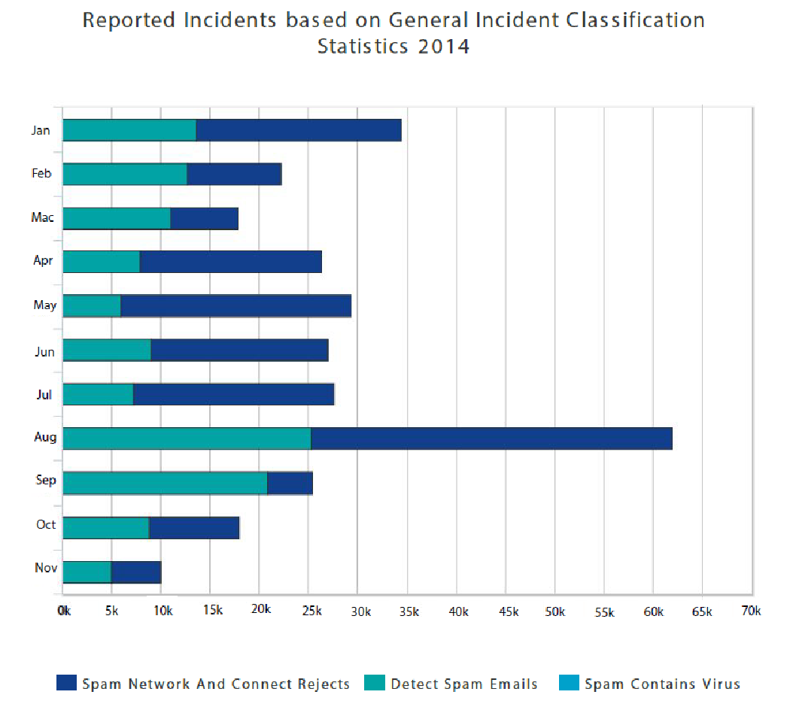
Cyberlaws of Malaysia
Cyber Security Malaysia’s report:

Slide 89
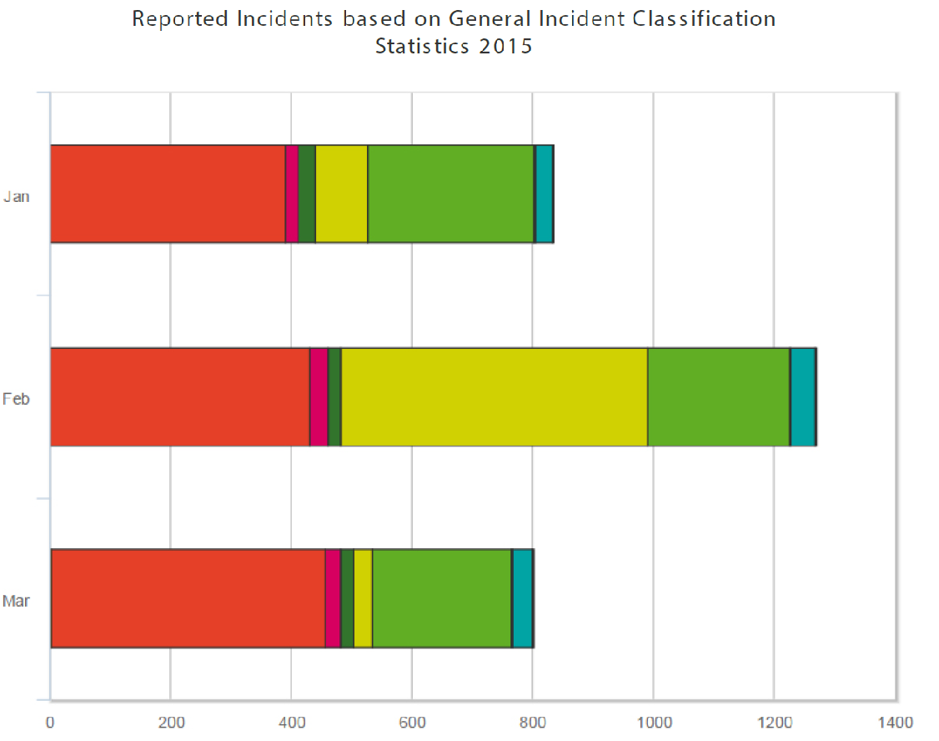
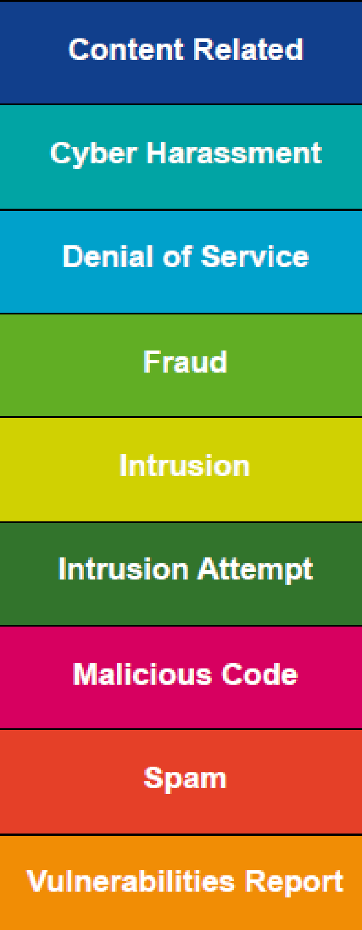
Cyberlaws of Malaysia
Cyber Security Malaysia’s report:

Slide 90
Cyber Threats in Malaysia
Economy
Online fraud and threats can undermine any efforts to promote economic development and stability. Being key in promoting investment opportunities and a healthy business environment, economic stability that is exposed to constant and serious online threat that can jeopardise years of any development e3ffort.
Online Fraud
Fraud cases can be propagated from a few countries and comprising of groups of individuals.
E.g. African Advance Fee Fraud scams, VOIP Spoofing Scams and SMS Scams.

Slide 91
Cyber Threats in Malaysia
Phishing
The collection of personal data through illegal means are now done internationally by electronic crime syndicates and in most cases, data are then used in collaboration with local syndicates to fully utilise or take advantage for the purpose of illegal gains.
E.g. in 2012, 332 phishing cases involved financial loses amounting to RM1,959,932.

Slide 92
Cyber Threats in Malaysia
User Content Issues
Blogs and other online publications offers a convenient platform for the purpose of publication of opinion and uncensored news but unfortunately open to abuse against individuals, organizations and even the government.
E.g. in 2012, 103 websites considered obscene was instructed to be taken down, 15 for contravening syarie laws, and 10 for contravening the Communications and Multimedia Act 1998.
Notes:
http://www.themalaymailonline.com/money/article/malaysia-lost-rm2m-to-phishing-last-year-says-mcmc

Slide 93
Cyber Threats in Malaysia
Cross Border Intellectual Property and Licensing Issues
The challenge of controlling crossborder transfer of IP especially of illegal material under Malaysia law.
Similarly, the subscription by Malaysians to sites considered illegal under Malaysian law such as pornography and gambling raises concerns over the control illicit material accessible to Malaysians besides control on outflow of funds.
Notes:
http://www.themalaymailonline.com/money/article/malaysia-lost-rm2m-to-phishing-last-year-says-mcmc

Slide 94
Cyber Threats in Malaysia
Information Theft
Corporate or business data being stolen for the benefit of competitors, whether by current employees or through th euse of technology such as Malwares or now better known as Crimeware.
Crime tools are now available online making amateurs able to perform online tasks such as to spoof websites or hack into systems easily unlike 5 to 10 years ago when it could only be performed by trained individuals.
Notes:
http://www.themalaymailonline.com/money/article/malaysia-lost-rm2m-to-phishing-last-year-says-mcmc

Slide 95
Cyber Threats in Malaysia
Social/Racial Balance
Unlimited and unrestricted online social interaction have spawned serious underlying issues
Most serious will be the use of fake online identities which more often than not leads to cheating cases
Exposure to false and malicious information that is spread via the internet and SMS have led to racial problems
The attacks have not only targeted the government and political parties but individuals and organizations.
Notes:
http://www.themalaymailonline.com/money/article/malaysia-lost-rm2m-to-phishing-last-year-says-mcmc

Slide 96
Cyber Threats in Malaysia
Terrorism
As with other online criminal networks, the threat of cyber terrorism cannot be taken likely whether in the form of direct attacks against Critical National ICT infrastructures, the spread of political or militant propaganda and even recruitment of potential members.
Extremist groups, separatist forces, advocates of ideas.
RMP have over the years monitored closely the online development particularly in relation to the spread of online propaganda. To date, more than 15 websites that are suspected have been taken offline or blocked with the cooperation of the Malaysian Communication Multimedia Commission.
Notes:
http://www.themalaymailonline.com/money/article/malaysia-lost-rm2m-to-phishing-last-year-says-mcmc

Slide 97
Cyber Threats in Malaysia
Current challenges in cybercrime investigation
Mobility of devices providing to be biggest challenge to law enforcement in tracking and analysing equipment
Introducation of new technologies and economic innovations. Ensuring adequate analytical and technical capabilities for law enforcement
Maintaining a comprehensive and relevant legal framework
Working in a borderless environment with laws of multiple jurisdictions. Issue of differences in national priorities.
Implementing information security practices and raising awareness.
Notes:
http://www.themalaymailonline.com/money/article/malaysia-lost-rm2m-to-phishing-last-year-says-mcmc

Slide 98
Cyber Threats in Malaysia
Out Response:
Review of current laws: Computer Crime Act, Evidence Act, Penal Code, etc.
Inter-agency task force (Local)
Participation in Awareness campaigns
Police Cyber Investigation Response Centre (PCIRC) – supported by the Mobile Intelligence System (MIS)
Departmental Training
Cybercrime investigations, VOIP, Wireless, Multimedia and Network Forensics.
Other Agency courses
Cyberlaw and cyber crime courses
Ilea (Bangkok), PTI (Bangkok/Manila) JCLEC (Jakarta)
Microsoft, Cisco
Notes:
http://www.themalaymailonline.com/money/article/malaysia-lost-rm2m-to-phishing-last-year-says-mcmc

